Slide 1
DYNAMIC PROGRAMMING

Slide 2


INTRODUCTION
FIBONACCI SERIES

Slide 3
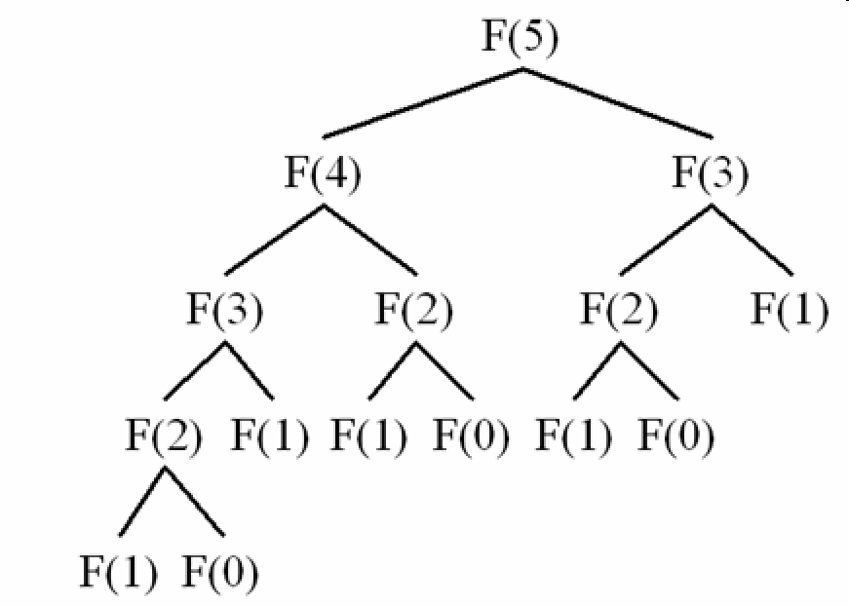
INTRODUCTION
Recursive Tree of Fibonacci Series

Slide 4
DYNAMIC PROGRAMMING
Dynamic programming is a technique for solving problems with overlapping sub problems.
Typically, these sub problems arise from a recurrence relating a given problem’s solution to solutions of its smaller sub problems.

Slide 5
DYNAMIC PROGRAMMING
Rather than solving overlapping sub problems again and again, dynamic programming suggests solving each of the smaller sub problems only once and recording the results in a table from which a solution to the original problem can then be obtained.

Slide 6
WEIGHTED INTERVAL SCHEDULING
Problem and Goal
We have n requests labeled 1, . . . , n, with each request i specifying a start time si and a finish time fi.
Each interval i now also has a value, or weight vi.
Two intervals are compatible if they do not overlap.

Slide 7
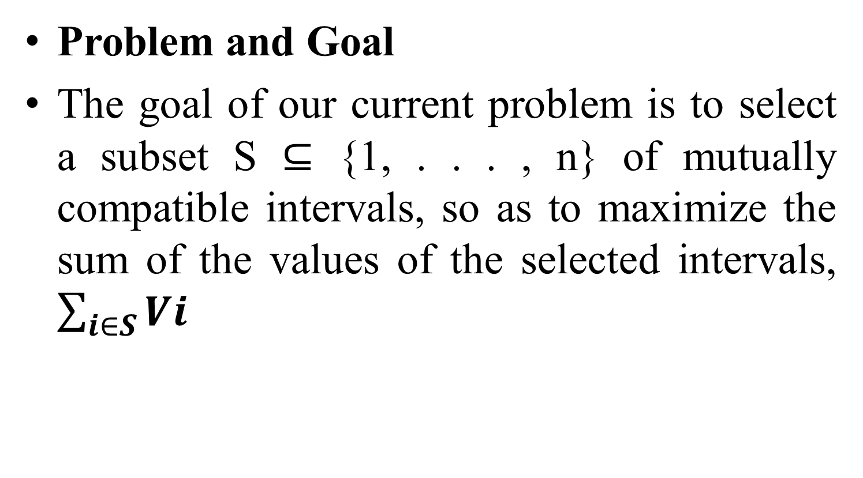
WEIGHTED INTERVAL SCHEDULING
Problem and Goal
The goal of our current problem is to select a subset S ⊆ {1, . . . , n} of mutually compatible intervals, so as to maximize the sum of the values of the selected intervals, $\sum_{i∈S}{Vi}$

Slide 8
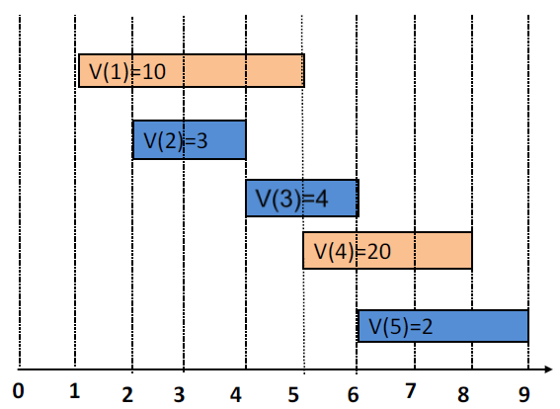
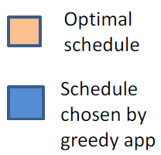
GREEDY DOES NOT WORK

Slide 9
WEIGHTED INTERVAL SCHEDULING
Compute predecessor of a request
We define p(j), for an interval j, to be the largest index i < j such that intervals i and j are disjoint i.e. interval i doesn't overlap with j.

Slide 10
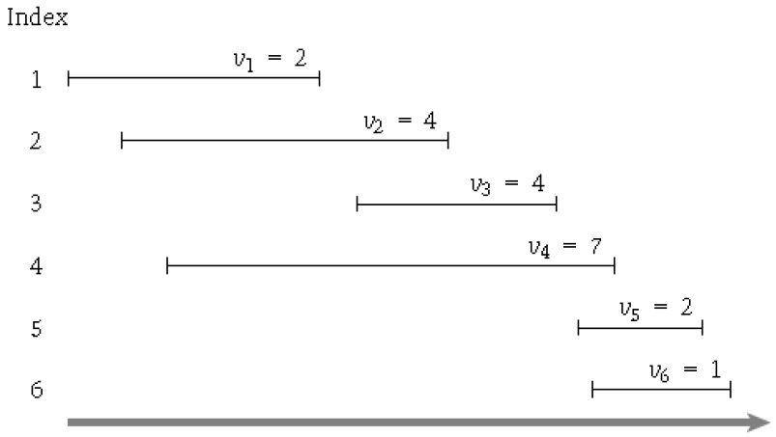
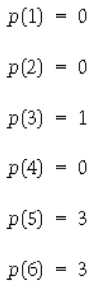
WEIGHTED INTERVAL SCHEDULING
Compute predecessor of a request

Slide 11
WEIGHTED INTERVAL SCHEDULING
Dynamic Programming Approach
Let us consider there is an optimal schedule OPT for the given set of requests and their values.
Let “n” be the last interval in the given set of requests.
If we want to find whether an interval “n” belongs to OPT there are 2 choices left. They are:
Interval “n” belongs to the OPT. If it belongs then we have to continue for further intervals that are compatible with interval “n” using p(n) calculated for the nth interval.
If it does not belong then, consider the set of intervals from set of {1,…,n-1}.

Slide 12
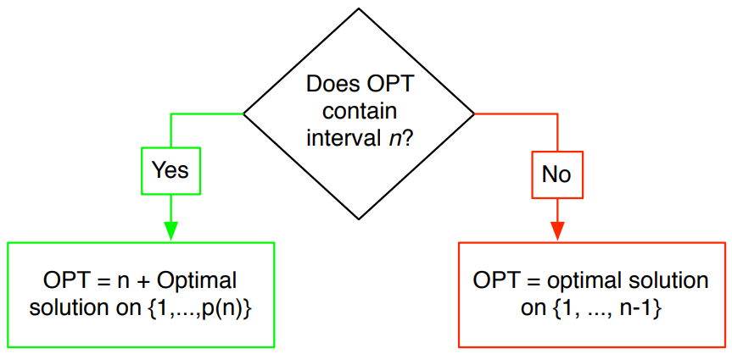
WEIGHTED INTERVAL SCHEDULING
Dynamic Programming Approach

Slide 13
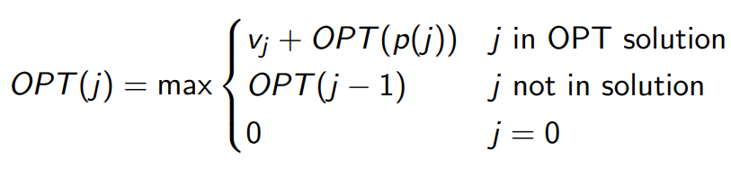
WEIGHTED INTERVAL SCHEDULING
Dynamic Programming Approach
The recurrence relation of a request “j” in the optimal set of requests can be denoted as OPT(j) given by

Slide 14
Algorithm implementing recurrence relation
//Purpose: To find the optimal weights for weighted interval scheduling problem.
//Input: 1….n requests each having start time “s” and finish time “f” and weight “v”
//Output: Optimal weight of the given set of “n” intervals.
Sort the intervals according to their finish times f1 ≤ f2 ≤ f3….. ≤ fn
Compute p(1), p(2)……., p(n)
j = nth interval
Compute-Opt (j):
If j = 0
Return 0
Else
Return max( v[j] + Compute-Opt (p[j]),Compute-Opt (j-1))

Slide 15
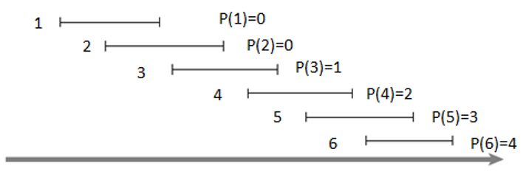
WEIGHTED INTERVAL SCHEDULING
Example

Slide 16
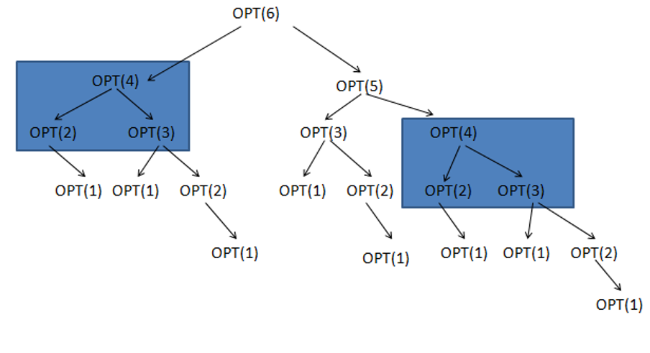
WEIGHTED INTERVAL SCHEDULING
Recursive Tree

Slide 17
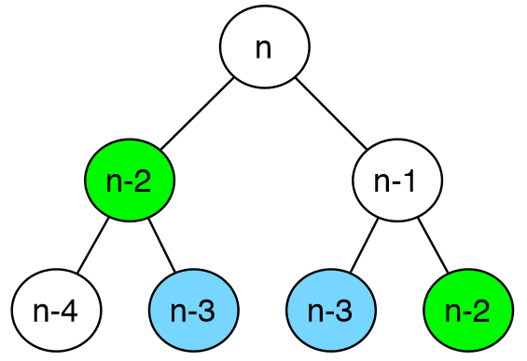
WEIGHTED INTERVAL SCHEDULING
This Takes Exponential Time

Slide 18
MEMOIZATION
The exponential time of the recursive procedure for weighted interval scheduling can be reduced using Memoization technique.
We can store the value of Compute-Opt in a globally accessible place the first time we compute it and then simply use this precomputed value in place of all future recursive calls.
This technique of saving values that have already been computed is referred to as memoization.

Slide 19
Memoization Algorithm
//Purpose: To find the optimal weights for weighted interval scheduling problem.
//Input: 1….n requests each having start time “s” and finish time “f” and weight “v”
//Output: Optimal weight of the given set of “n” intervals.
M-Compute-Opt(j)
If j = 0 then
Return 0
Else if M[j] is not empty then
Return M[j]
Else
Define M[j] = max(vj + M-Compute-Opt(p(j)), M-Compute-Opt(j − 1))
Return M[j]
Endif

Slide 20
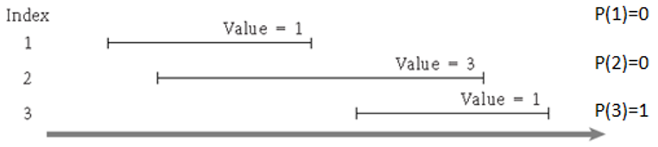
MEMOIZATION
EXAMPLE

Slide 21
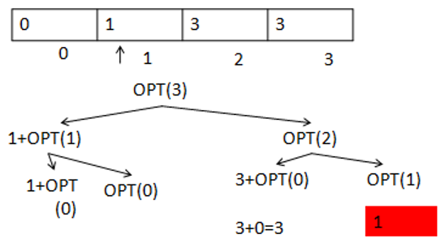
MEMOIZATION

Slide 22
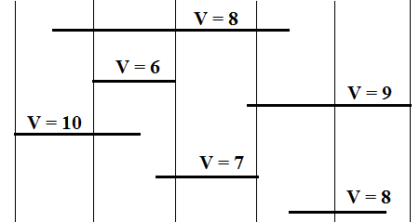
MEMOIZATION
Apply the Memoization algorithm for the following problem.

Slide 23
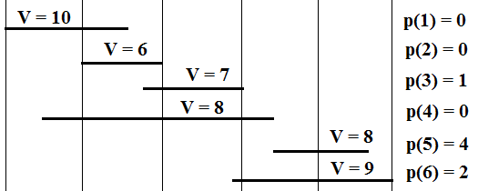
MEMOIZATION
Solution:
1. Sort the Intervals according to the finish time. (f1 < f2 < f3 . . .< f6)
2. Compute Predecessors.
3. Draw Recursive Call Tree.

Slide 24
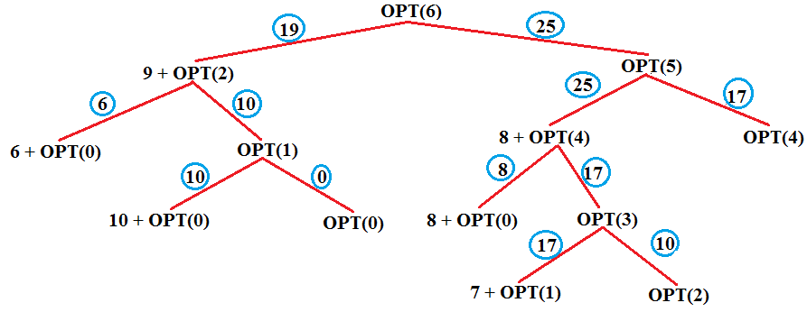
MEMOIZATION
M[0] | M[1] | M[2] | M[3] | M[4] | M[5] | M[6]
0 | 10 | 10 | 17 | 17 | 25 | 25

Slide 25
MEMOIZATION
Find the intervals that belong to the output set.
Given the global array M we can find the intervals that belong to the output set using the following relation and algorithm.
Relation: vj + OPT(p(j)) ≥ OPT(j − 1).

Slide 26
Algorithm Find-Solution(j)
//Purpose: To find the intervals belonging to the output set for weighted interval scheduling problem.
//Input: 1….n requests each having start time “s” and finish time “f” and weight “v”
//Output: The intervals belonging to the output set for weighted interval scheduling problem.
Find-Solution(j)
{
if (j > 0)
if (vj + M[p(j)] > M[j-1])
print j
Find-Solution(p(j))
else
Find-Solution(j-1)
}

Slide 27
MEMOIZATION
Example:

Slide 28

MEMOIZATION
Example:
N | Global Array M | Vj + M[p(j)] | M[j-1] | Output Set
6 |  | 1 + 6 = 7 | 8 | { } Find_solution(5)
5 |  | 2 + 6 = 8 | 7 | {5} Find_solution(3)
3 |  | 4 + 2 = 6 | 4 | {5, 3} Find_solution(1)
1 |  | 2 + 0 = 2 | 0 | {5, 3, 1} Find_solution(0)
0 | 2 | 4 | 6 | 7 | 8 | 8

Slide 29
ITERATIVE PROCEDURE
We have Iterative Procedure to calculate the global array “M” and use the find solution method to find the max weight possible and intervals in the output set respectively.

Slide 30
Iterative Algorithm
//Purpose: To find the optimal weights for weighted interval scheduling problem.
//Input: 1….n requests each having start time “s” and finish time “f” and weight “v”
//Output: Optimal weight of the given set of “n” intervals.
Iterative-Compute-Opt
M[0]= 0
For j = 1, 2, . . . , n
M[j] = max (vj + M[p(j)], M[j − 1])
Endfor

Slide 31
ITERATIVE PROCEDURE
Example:

Slide 32
ITERATIVE PROCEDURE
Example:
M
j = 1
M[1] = max (vj + M[p(j)], M[j − 1])
M[1] = max (2 + M[0], M[0])
M[1] = max (2 + 0, 0)
0 | 1 | 2 | 3 | 4 | 5 | 6
0 | 2

Slide 33
ITERATIVE PROCEDURE
Example:
M
j = 2
M[2] = max (vj + M[p(j)], M[j − 1])
M[2] = max (4 + M[0], M[1])
M[2] = max (4 + 0, 2)
0 | 1 | 2 | 3 | 4 | 5 | 6
0 | 2 | 4

Slide 34
ITERATIVE PROCEDURE
Example:
M
j = 3
M[3] = max (vj + M[p(j)], M[j − 1])
M[3] = max (4 + M[1], M[2])
M[3] = max (4 + 2, 4)
0 | 1 | 2 | 3 | 4 | 5 | 6
0 | 2 | 4 | 6

Slide 35
ITERATIVE PROCEDURE
Example:
M
j = 4
M[4] = max (vj + M[p(j)], M[j − 1])
M[4] = max (7 + M[0], M[3])
M[4] = max (7 + 0, 6)
0 | 1 | 2 | 3 | 4 | 5 | 6
0 | 2 | 4 | 6 | 7

Slide 36
ITERATIVE PROCEDURE
Example:
M
j = 5
M[5] = max (vj + M[p(j)], M[j − 1])
M[5] = max (2 + M[3], M[4])
M[5] = max (2 + 6, 7)
0 | 1 | 2 | 3 | 4 | 5 | 6
0 | 2 | 4 | 6 | 7 | 8

Slide 37
ITERATIVE PROCEDURE
Example:
M
j = 6
M[6] = max (vj + M[p(j)], M[j − 1])
M[6] = max (1 + M[3], M[5])
M[6] = max (1 + 6, 8)
0 | 1 | 2 | 3 | 4 | 5 | 6
0 | 2 | 4 | 6 | 7 | 8 | 8

Slide 38
THANK YOU

